Slide 1

Business Analytics Project
Edoardo Manieri - Luca Masserano – Edoardo Pericoli

Slide 2

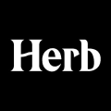


A Bit of Background…
Peculiar start-up names
Far from being random…
Notes:
The idea for this project came from the observation that especially in the last years many startups have been paying a lot of attention in devising their names, sometimes coming out with very peculiar choices.
Just to mention a few, you can now find your mortgage through a company named Morty, rent your neighbor’s stuff with another called Fat Lama and get your cannabis news from a community called Herb.
«So» these kind of links which use slang or particular textures are surely far from being random, with first names, foods and animals being really popular lately.
During the last decades many different name patterns have been following each other, with companies trying to exploit current economic trends by putting words such as.com or AI either in their names or in their official descriptions in order to hype their birth a bit.

Slide 3

The Theory
Different start-up names and descriptions have a different impact on raising funds by investors
Notes:
Our idea is that the design of the name and the description has a real but non well-identified effect on the amount of funds obtained at the seed stage (i.e. the very first phase of a company development).
The aim of this project is to identify the features of the name and the description that are more influential on the willingness of an investor to give funds to a specific startup, controlling for country, relevant market, historical period and performance at the second stage.
As a side effect we could possibly find an ideal design method to devise the most effective name and description of a startup.

Slide 4
The Dataset
Startups founded from 1990 to 2014
Scraped data about startups founded from 2015 to 2018
From 754 markets to 19 categories
Descriptions scraped from web (work in progress)
Notes:
We base our research on a worldwide dataset found on Crunchbase of all startups founded from 1990 to 2014. We are now integrating it with additional data from 2015 to 2018 scraped from the web.
(then we realized that every company was assigned to a not very meaningful sector)
The dataset contained a classification of all companies into 754 different market categories, which we grouped into 19 non-overlapping sectors to make the analysis clearer and more effective.
(we reassigned every company to a significant category)
In addition, we are implementing a web crawler in order to obtain all startups’ official descriptions.

Slide 5
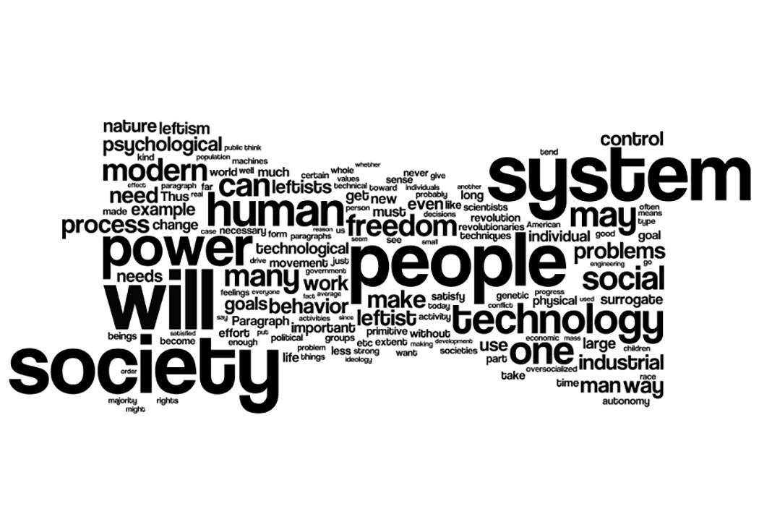
The Method
Features:
Most common substring
Presence of trending words in the name
Use of trending words in the description
Semantic similarities
Notes:
We want to build a regression model that captures the average causal effect on raised funds of adding a specific feature to the name or specific words to the official description.
(we claim that startups with those feature are going to raise more funds because investors have a cognitive bias)
(There are actually some features we are going to look at, and they are:)
Namely, so far we are working on the following bullet points:
Most common substring/word of the name → using edit/Levenshtein distance (it computes how much is similar one word to another)
Use of trending words in the name → Google trend
Use of trending words and topics in the description
(Possibly) Use of semantic similarities between names and descriptions → NLP algorithms for keyword extraction
Other basic features: length, # words in the name, # vowels/consonants

Slide 6
THANK YOU

